Slide 1
Shape and Motion from Image Streams under Orthography: a Factorization Method
From Tomasi & Kanade 1991a
—— Group Member: Jieting Chen, Anbang Ye, Yicheng Sun, Jinbo Ci

Slide 2


THE Factorization Method
— with the assumption of orthographic graph
Represent an image sequence as a 2F$×P$ measurement matrix W, which is made up of the horizontal and vertical coordinates of P points tracked through F frames.
U —— an F$×$P matrix with one row per frame and one column per feature point
recording the horizontal feature coordinates
V —— an F$×$P matrix with one row per frame and one column per feature point
recording the vertical feature coordinates
$$W=[\frac{U}{V}]$$
The 2F$×P$ measurement matrix W can be factored into the product of two matrices R and S.
R —— 2F$×3$ matrix that represents camera rotation
S —— 3$×P$ matrix that represents shape in a coordinate system attached to the object centroid.

Slide 3

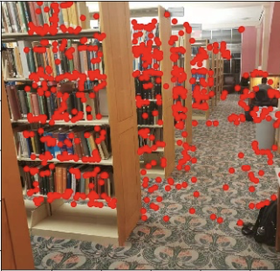
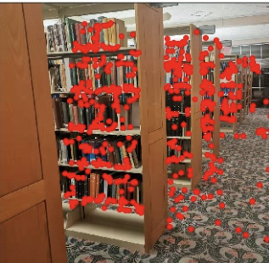
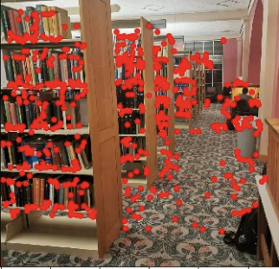
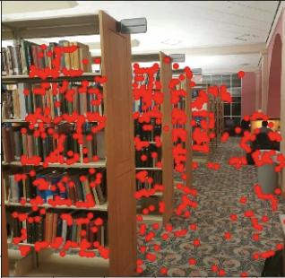
Before Start: Find the corresponding P points
Select any four frames from all input images
Find the corresponding interesting points between the first frame with the other three frames
Find the common interesting points existing in all four frames
Use RANSAC Method to filtrate and get “good” interesting points

Slide 4
the coordinates of feature points in world-centered or camera-centered coordinate?
With the perspective projection and a camera-centered representation of shape, the position of feature points is specified by their image coordinates and by their depths, defined as the distance between the camera center and the feature points, measured along the optical axis.
Unfortunately, although a camera-centered representation simplifies the equations for perspective projection, it makes shape estimation difficult, unstable, and noise sensitive.

Slide 5
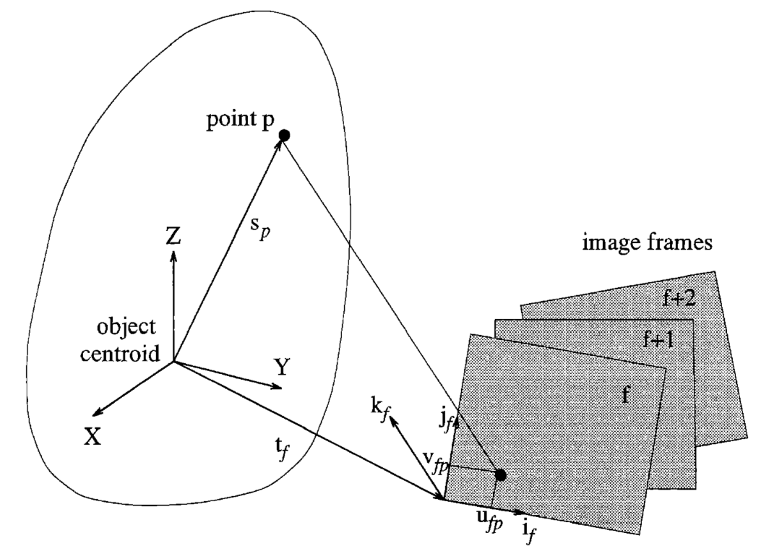

The orientation of the camera reference system corresponding to frame number f is determined by a pair of unit vectors i_{f} and j_{f} pointing along the scanlines and the columns of the image respectively, and defined with respect to the world reference system. Under orthography, all projection rays are then parallel to the cross product of i_{f} and j_{f} .
The image feature position of points $s_{p}=\left(x_{p},{ y}_{p},{ z}_{p}\right)T$ onto frame f is given by the equation
$ufp$ = $i_{f}^{T}(s_{p} − t_{f})$
$vfp$ = $j_{f}^{T}(s_{p} − t_{f})$
where $t_{f}$is the vector from the world origin to the origin of image frame f

Slide 6







The FIRST step: compute the SVD $\tilde{W}$
We have tracked P feature points over F frames in an image stream, record the result as
$\{\left(ufp, vfp\right)$ | f = 1, … F, p = 1, … P$\}$
write the horizontal feature coordinates $ufp$ into matrix U
write the vertical feature coordinates $vfp$ into matrix V
U —— an F$×$P matrix with one row per frame and one column per feature point
recording the horizontal feature coordinates
V —— an F$×$P matrix with one row per frame and one column per feature point
recording the vertical feature coordinates
$$W=[\frac{U}{V}]$$
In order to be centered at the object centroid, the rows of the matrix U and V are registered by subtracting from each entry the mean of the entries in the same row.
$\tilde{ufp}=ufp$ – a_{f}
$\tilde{vfp}=vfp$ – b_{f}
$a\text{f}$ = $\frac{1}{P}\sum_{p=1}^{P}{ufp}$
$b\text{f}$ = $\frac{1}{P}\sum_{p=1}^{P}{vfp}$
This produces two new F$×$P matrices $\tilde{U}=[\tilde{ufp}]$ and $\tilde{V}=[\tilde{vfp}$]
The matrix $\tilde{W}$ = [$\frac{\tilde{U}}{\tilde{V}}$], is called the registered measurement matrix
Notes:
We have told how we get W before, in more detail…

Slide 7
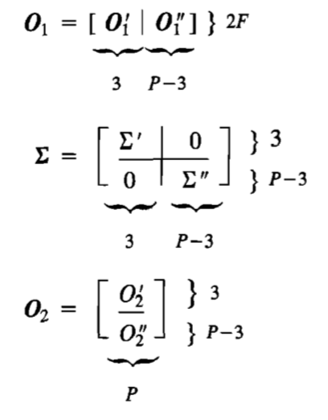





The second step: decompose the $\tilde{W}$ and calculate $\tilde{R}$ and $\tilde{S}$
The matrix $\tilde{W}$ can be decomposed into a 2F$×P$ matrix O₁, a $P×P$ diagonal matrix $∑$, and a $P×P$ matrix O₂, that is, operate SVD on $\tilde{W}$ and $\tilde{W}$ = O₁ $∑$ O₂
O₁ and O₂ are orthograph matrices and $∑$ is a diagonal matrix.
Suppose that we pay attention only to the first three columns of O₁, the first $3×3$ submatrix of $∑$ and the first three rows of O₂.
Then $\tilde{R} \text{= }\text{O}\text{1}\text{’} \text{[}∑\text{r}\text{]}\text{1/2}$ and $\tilde{S} \text{= [}∑\text{r}\text{]}\text{1/2} \text{O}\text{2}\text{’}$
where the primes refer to the block partitioning in the picture.
We can write $\tilde{W}$ = $\tilde{R} \tilde{S}$
However, the decomposition is not unique. In fact, if Q is any invertible $3×3$ matrix, the matrices $\tilde{R}$Q and Q⁻¹$\tilde{S}$ are also a valid decomposition of $\tilde{W}$.
Notes:
Rank Theorem for Noisy Measurements:
The best possible shape and rotation estimate is obtained by considering only the three greatest singular values of $\tilde{W}$, together with the corresponding left and right
eigenvectors.

Slide 8
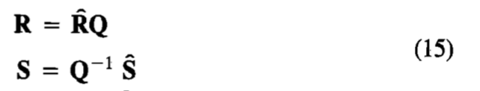
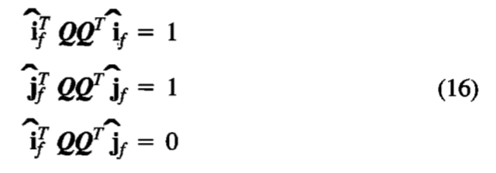

The last two steps: calculate out R and S
The third step: Compute the matrix Q in equation (15) by imposing the metric constraints (equation (16)).
The fourth step: Compute the rotation matrix R and the shape matrix S as $R=\tilde{R}$Q and $S=$Q⁻¹$\tilde{S}$
To calculate Q, we meet the problem and find out the method that …

